Slide 1


SAP ABAP
CAPSTONE
PROJECT
ABDUL RAHMAN ABDUL WAHAB

Slide 2

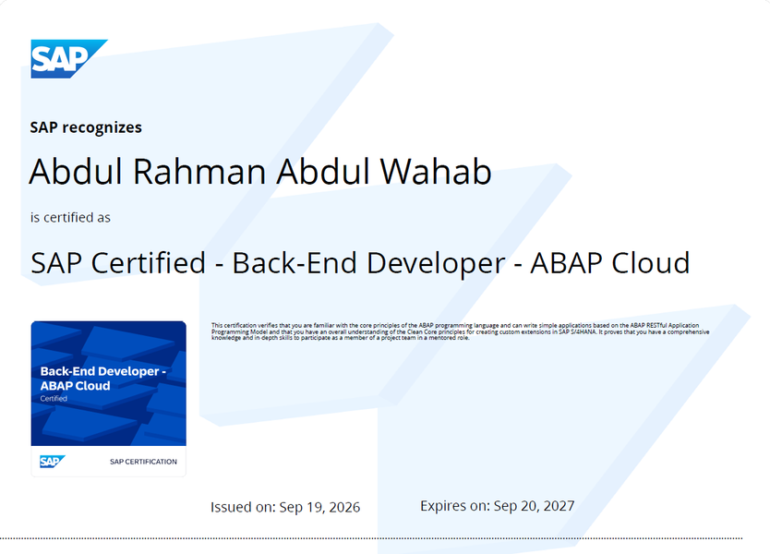

SAP ABAP
SAP Global Certified ABAP Developer
Capstone Projects
EMS Module Pool Dashboard
Skills: custom screen dialogs, BDC, ALV, SmartForm.
GitHub Repository Link
Scenario-Based Projects
Nestle & Maruti Implementations
Skills: DDIC Standard Tables, ALV Report, SmartForm
GitHub Repository Link
50+ Practice Programs
Structured, well-documented GitHub practice programs spanning from basic logic to advanced reports.
Show credential
GitHub Repository Link

Slide 3
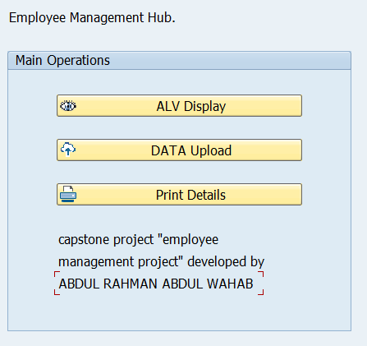
Module Pool Dashboard
Employee Management System
Requirements
A centralized, custom SAP application (EMS).
Handling bulk data uploads, real-time grid reporting, official document printing.
Implementation Steps
  Database - Designed custom transparent table
  Data Migration - Implemented BDC recording
  ALV Reporting - Developed interactive data retrieval
  SmartForms - For structured employee document printing
  Module Pool - Unified all workflows into dialog program
GitHub Repository Link

Slide 4
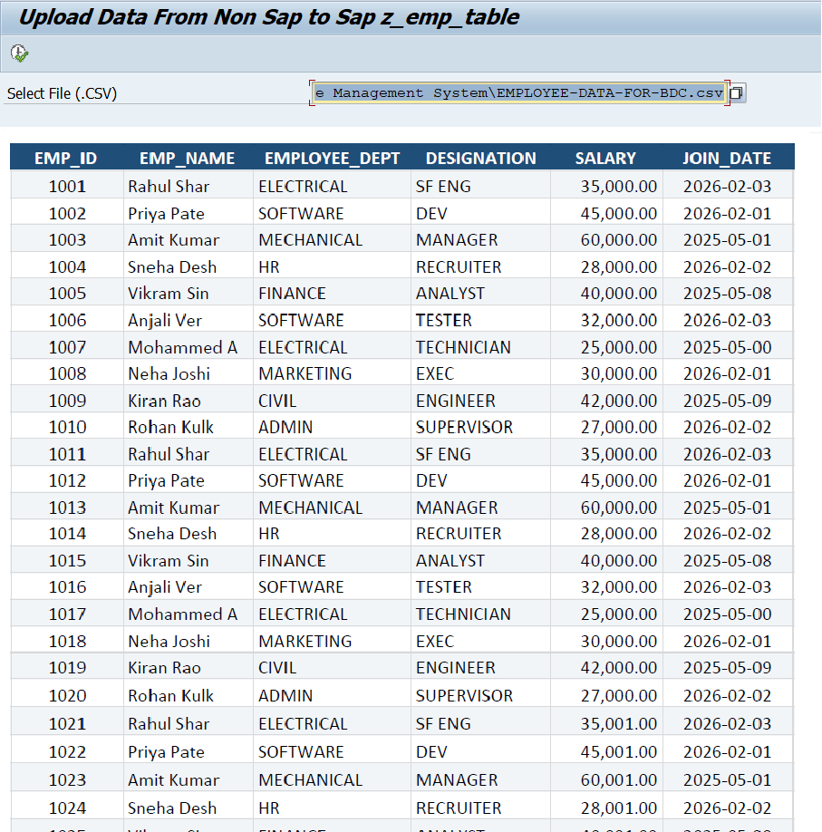
1: Data Migration
Technique Used: BDC (Batch Data Communication)
Source Data Input: Parses flat file structures (.CSV / Excel) containing bulk employee records.
Source Code

Slide 5
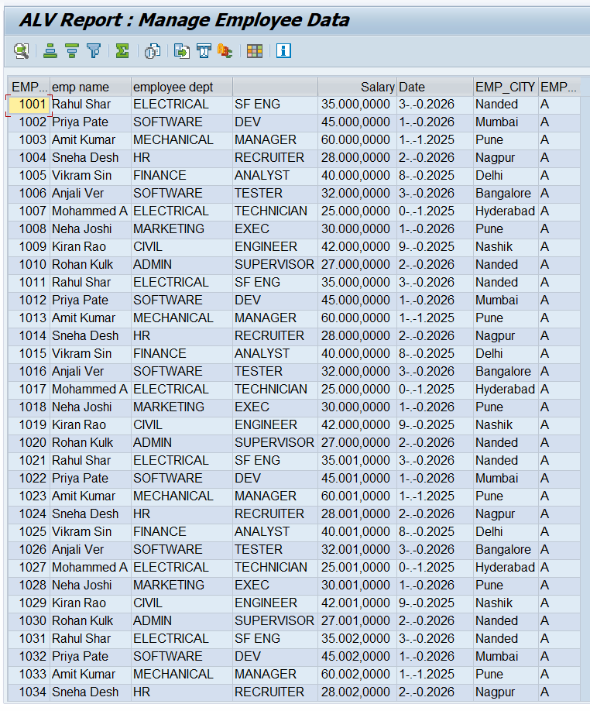
2: ALV Report
Function Used: 'REUSE_ALV_FIELDCATALOG_MERGE'
Source Table Fetches dynamic records directly from transparent table ZDTBL_EMP_MAN_SY into internal memory.
Source Code

Slide 6
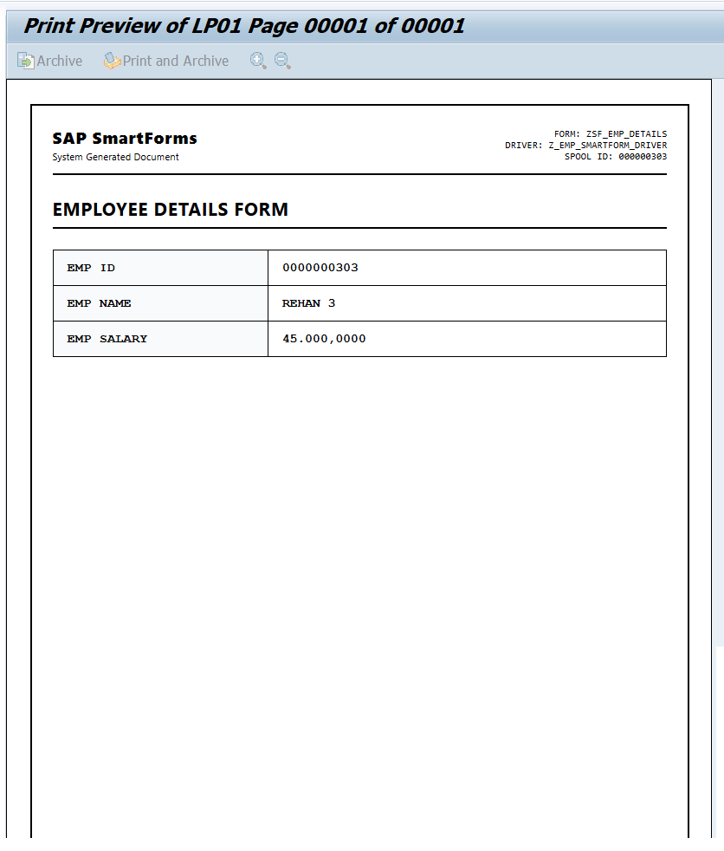
3: Document Printing
Form Used: SmartForm Frame Structure
Function Used in program: Generated function module Smart Form ‘SSF_FUNCTION_MODULE_NAME’
Source Code

Slide 7




CONCLUSION
Core Learnings from the Capstone Project
Data Modeling & DDIC
Dialog Programming
ALV & SmartForms
Batch Data Migration
Designed custom transparent tables (), domain types, structures, and table types from scratch in ABAP Dictionary.
Mastered Module Pool screen painter, PBO/PAI logic execution, user command flow, and table controls.
Implemented interactive ALV Grid features and designed driver programs with custom SmartForms for official employee documentation.
Built BDC batch input recording scripts to parse external CSV data and execute automated bulk database uploads safely.

Slide 8
THANK YOU!!

